Slide 1
Finance Dept Cost control, planning, budgeting & financial analysis
planning, budgeting, Communication (Integration) & control information System

Slide 2
Index
Introduction
Gaps, Cases & Difficulties
Cost Accounting
ERP System Implementation
Training
Goals
Establishing Cost Accounting Division
Establishing Planning, Budgeting, Development & Growth Committee
Dedicated ERP System Project Management Skills (Key Users)
Information System Data Flow
Requirements
Cost, Budgeting, ERP Accountant for each Project more than 50 Millions SAR
Cost, Budgeting & ERP Accounting Team for Each Project more than 100 Millions SAR
Cost, Budgeting, ERP Accountant for Each Factory
Stock, Purchase & Budget Accountant
Team Training

Slide 3
INTRODUCTION

Slide 4
Gaps
Project Cost Control Includes Time, Values & Quantities
Manufacturing Cost Control Time, Values & Quantities
Budget Analysis and Reporting
Cash flow Control
Accounting Accuracy Including Cost & Revenue
Timeline Control for Projects & Fabrication (Time Late)
Stagnant inventory
Financial Liquidity
New Big Projects
ERP System Implementation very Slow

Slide 5
Case 1
Case of Budget Comparison:
We tried to Make Comparison between Planned Budget for 2024 and actual figures but it couldn’t
- you have to see the following figure:

Slide 6
Figure of Case 1
Jan 2024 | Budget | Actual
Cash and cash equivalents, beginning of period | 5,289,017.00 | 5,289,017.00
Outstanding Receipts | 21,967,700.65 | 21,967,700.65
Outstanding Payments | - 16,678,683.65 | - 16,678,683.65
Total Cash and cash equivalents, beginning of period | 5,289,017.00 | 5,289,017.00
Net increase in cash and cash equivalents | 6,196,646.90 | 26,659,335.37
Cash flows from operating activities | - 3,897,351.10 | 19,635,182.72
Advance Payments received from customers | - | 3,512,076.32
Cash received from operating activities | 39,086,159.81 | 21,254,302.87
موردون - دفعات مقدمة | 590,892.00 | -
VAT Output | 5,021,121.89 | 3,720,179.02
عملاء دفعات مقدمة | 10,883,958.92 | 3,512,076.32
ايرادات _ المشاريع بضريبه مبيعات 15% | 22,590,187.00 | 17,534,123.85
Total Cash received from operating activities | 39,086,159.81 | 21,254,302.87
Advance payments made to suppliers | - | -
Cash paid for operating activities | - 42,983,510.91 | - 1,619,120.15
ضمان أعمال | - 9,255,999.00 | -
VAT Input | - 3,434,135.52 | - 1,619,120.15
Raw Material - Cost Control COGS | - 19,119,609.39 | -
Manpower - Cost Control COGS | - 4,668,939.00 | -
Machinery - Cost Control COGS | - 431,011.00 | -
Subcontractors - Cost Control COGS | - 1,913,771.00 | -
Mescellanious (IndirectCosts) - Cost Control COGS | - 2,020,737.00 | -
Overheads - Cost Control COGS | - 1,889,024.00 | -
مصروفات مدفوعة من قبل العميل | - 250,285.00 | -
Cash flows from unclassified activities | 10,093,998.00 | -
Cash and cash equivalents, closing balance | 11,485,663.90 | -
Outstanding Receipts | 64,195,255.51 | -
Outstanding Payments | - 52,709,591.61 | -
Total Cash and cash equivalents, closing balance | 11,485,663.90 | -

Slide 7
Difficulties of The Case 1
Revenue Items (Sales Invoice Items) not related with Cost Items
No Cost Item Details Available For All of Material, Manpower, Machinery, Overheads ETC…
No Relation Between TimeLine and The Invoiced Items (Receipts or Revenue)
No Relation Between TimeLine and The Purchase Items (Payments or Costs)
We can’t determine The Revenue or Cost for which Period so we can handle the cash flow Budget
Can’t Integrate between Timeline and Collection, Customer, Material , Manpower, Overheads ETC…
Note: All the above Gaps can not resolve without Cost Accounting System Includes Detailed Budget

Slide 8
Case 2
Case of Cost Control Project DHC HOTEL :
We tried to Make Comparison between Estimation Budget and actual figures including Purchase but we couldn’t
- you have to see the below figure:

Slide 9
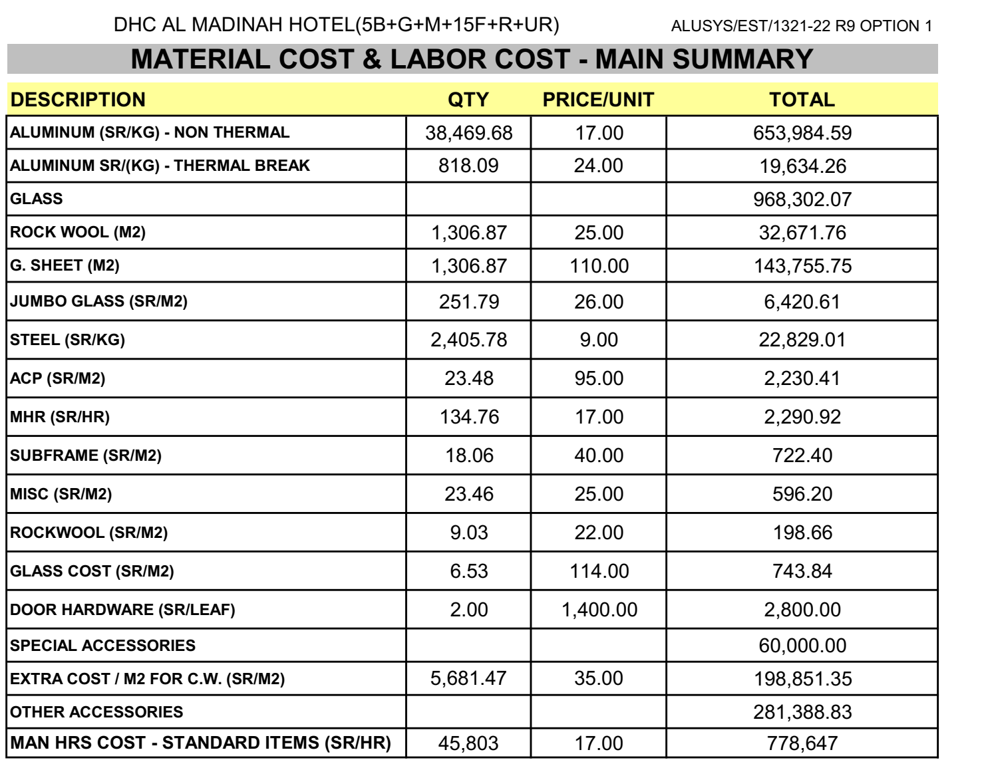
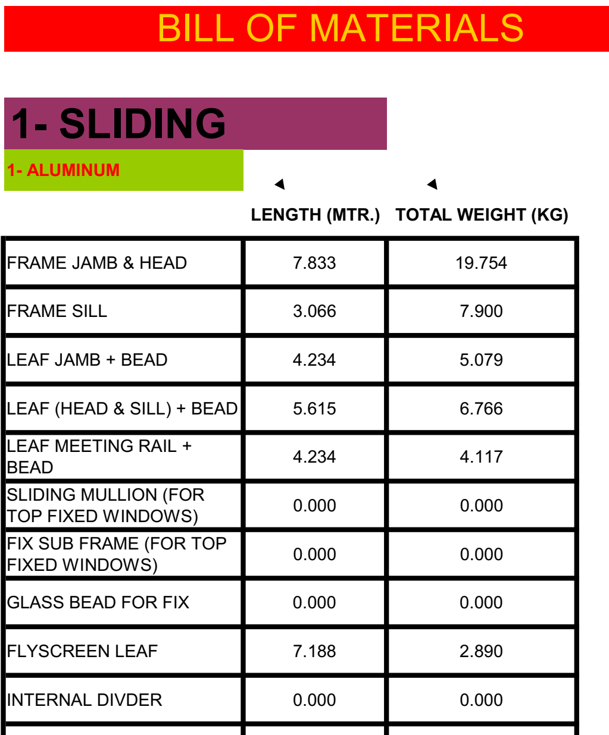
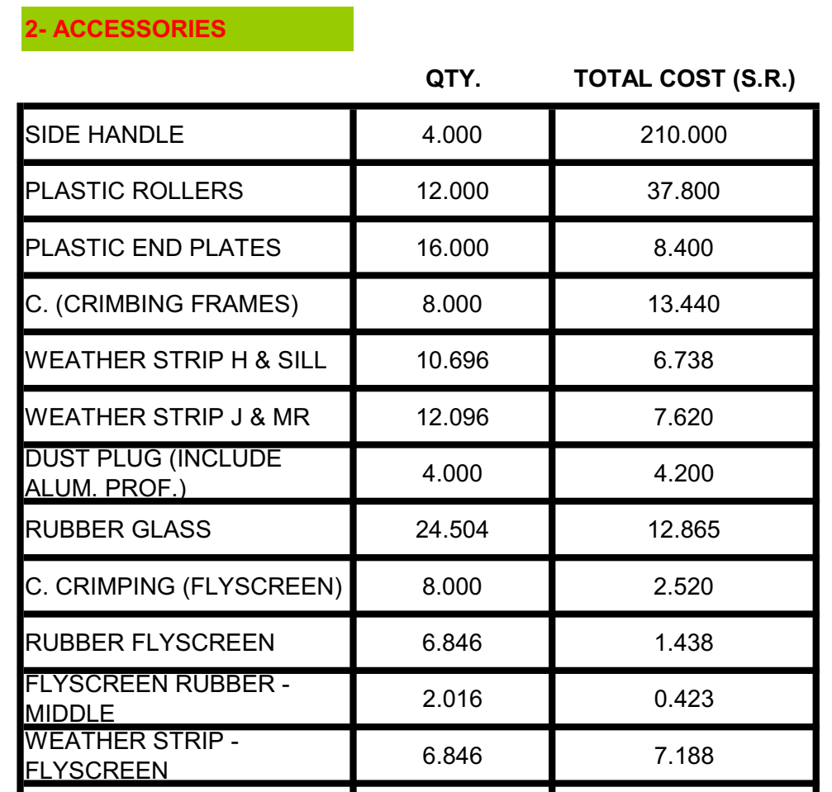
Figure of Case 2

Slide 10
Difficulties of The Case 2
No Finished or Sales Product Costs Item Details Includes Material, Manpower, Machinery ETC …
For Example we Can’t Determine Accessories Costs for Each Product Unit
Can’t Distributing Customs & Shipment Costs per Cost Items then Sales Items
No Timeline for Project Purchase Items VS Project Revenue So, we can Create A Project Cash Flow Budget, Cause of each Purchase Item has its own Specs, Nature, TimeLine ETC…
Note: All the above Gaps can not resolve without Detailed Budget with Action Plan and Time Schedule

Slide 11
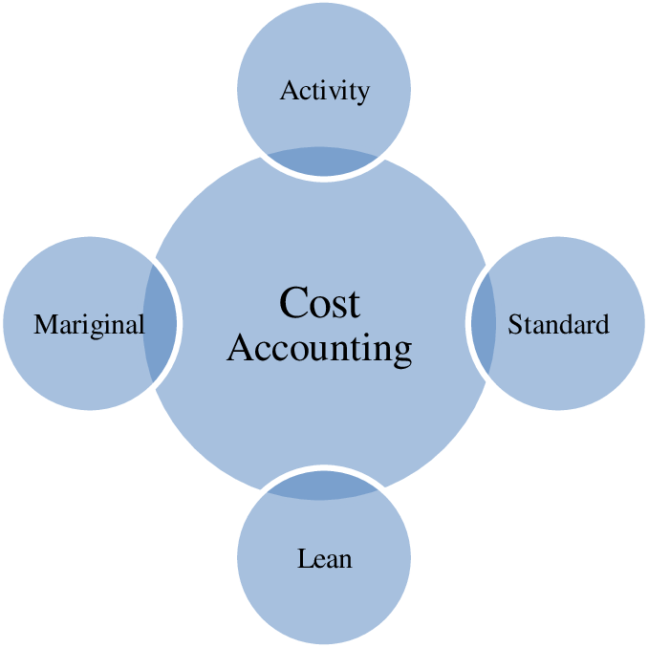
Cost accounting
Cost accounting is the reporting and analysis of a company's cost structure. Cost accounting involves assigning costs to cost objects that can include a company's products, services, and any business activities.

Slide 12
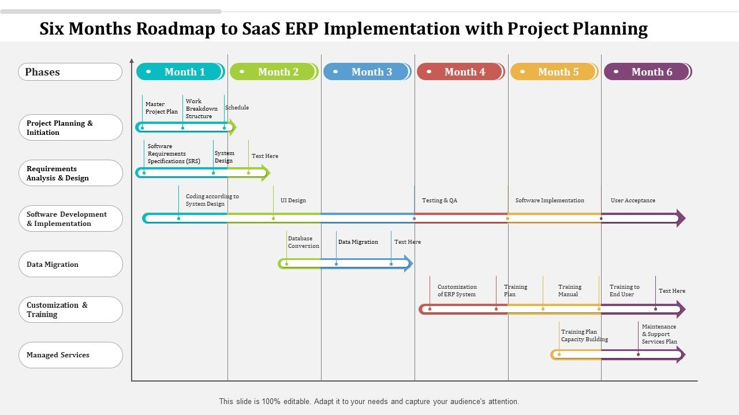
ERP System Implementation (Integration)

Slide 13
Goals

Slide 14
Establishing Cost Accounting Division
Tasks of the Cost Accounting (Project & Manufacturing):
Main Partner In The Planning and Development Committee & Its Tasks
Establishing & Training of Project Cost Accounting
Establishing & Training of Manufacturing Cost Accounting
Training of ERP System for General Accounting Dept.
Cost deviation reports
Budgeting
Direct salaries
Accounting integrations
Controlling costs
Financial analysis
Management assistance
Cost and revenues
Expenses
Expectation
Inventory Control

Slide 15
Establishing Planning, Budgeting, Development & Growth Committee
Tasks of the Planning and Development Committee:
Supervising the preparation and processing of the company’s strategic & implementation plan.
Follow up on the implementation, evaluation and update of the strategic plan.
Develop indicators to measure performance.
Follow up and evaluate the annual executive plans of departments and divisions periodically in light of the executive and strategic plan.
Review weekly/monthly/annual periodic reports and measure actual achievement rates.
Submitting reports to senior management with feedback on annual evaluations and measuring the level of progress achieved
Preparing development studies in light of periodic evaluation results

Slide 16
Establishing ERP System Project Management Skills (Key Users or Committee)
Tasks of the ERP System Project Management (Committee):
Identify and meet with the stakeholders
Build a comprehensive plan
Goals and objectives
Define the needed resources
Task assignment
Budget
Status updates
Risk management

Slide 17
Information System Data Flow
Finance
Planning and Development
Human Resource
Manufacturing
Logistic (Dispatch)
Information System
Stock Management
Maintenance
Procurement
Sales and Marketing
Quality Management

Slide 18
Requirements

Slide 19
Assign Cost Accounting Division
Projects (Contracts Cost Accounting) Including Planned Cost Budget, Cost Registrations & Analyzing
Tasks of the project cost accountant:
Monitoring the disbursement and cash flow of the project
Follow up on the project’s bank accounts
Monitoring the receipt and disbursement of project materials
Direct wage monitoring (attendance and salaries)
Monitoring other industrial costs (indirect) of the project
Follow up and inventory the work under implementation
Follow up on customer extracts (quantity and value)
Follow up on the project budget
Preparing and directing cost and revenue accounts for the project
Preparing periodic reports (weekly, monthly, etc.) for the project
Preparing performance reports and completion rates for the project

Slide 20
Assign Cost Accounting Division
Manufacturing (Industrial) Cost Accounting Including Planned Cost Budget, Cost Registrations & Analyzing
Tasks of the Factory cost accountant:
Monitoring the disbursement and cash custody of the factory
Follow up on the factory’s bank accounts
Monitoring the receipt and disbursement of factory materials
Direct monitoring of wages (attendance and salaries)
Monitoring other (indirect) industrial costs in the factory
Follow up on production under operation and final production
Follow up on customer extracts (quantity and value)
Follow up on the factory budget
Preparing and directing cost and revenue accounts for the factory
Preparing periodic reports (weekly, monthly, etc.) for the factory
Preparing performance reports and completion rates for the factory

Slide 21
Assign Planning and Development Committee
Planning and Development Committee Members:
Executive Management
Admin Management
Finance Dept.
Cost Accounting Dept.
Technical Office
Project Management
Manufacturing Management
ERP System Committee

Slide 22
Assign ERP System Project Management (Committee)
ERP System Project Management (Committee) Members:
Admin Management
Finance Dept.
Planning Dept.
Engineering Office
Project Management
Manufacturing Management
Stock, Purchase & Dispatch Management

Slide 23
The end thanks
Ahmed Ouf

